Slide 1

Team7
ITMO WAD 2021 SPRING
Student Management web app

Slide 2
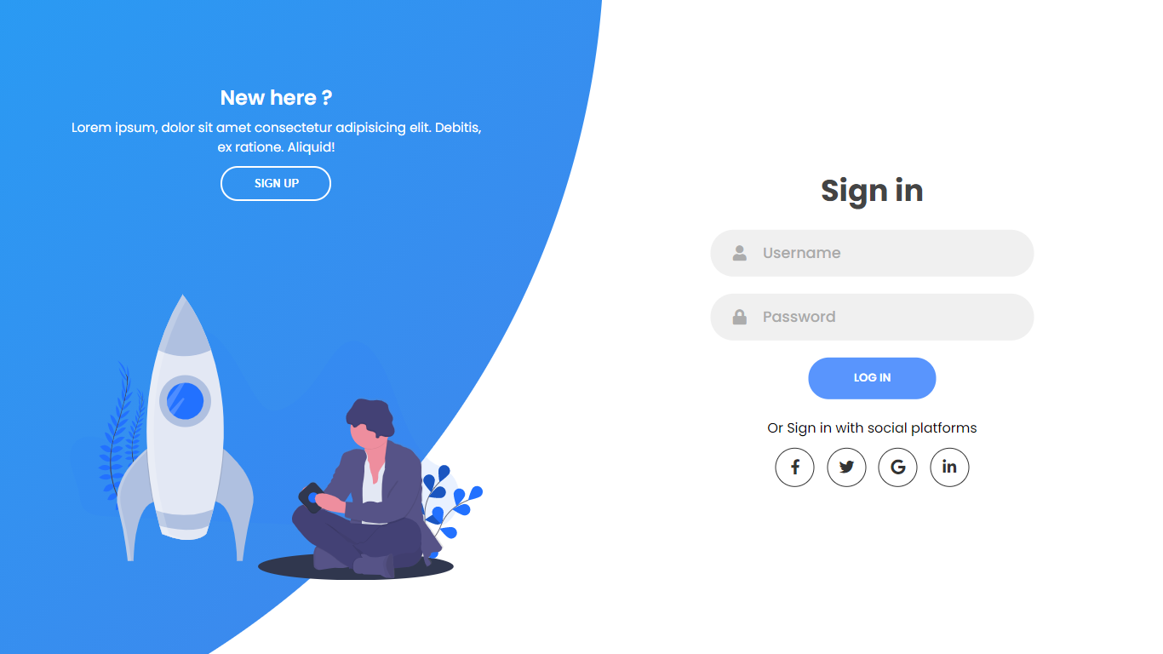

Slide 3
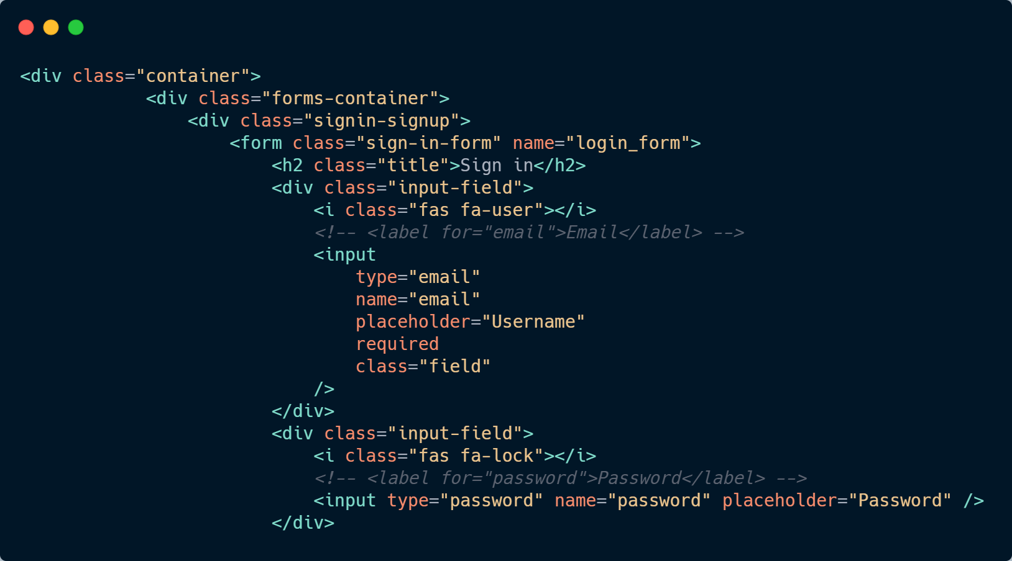

Slide 4
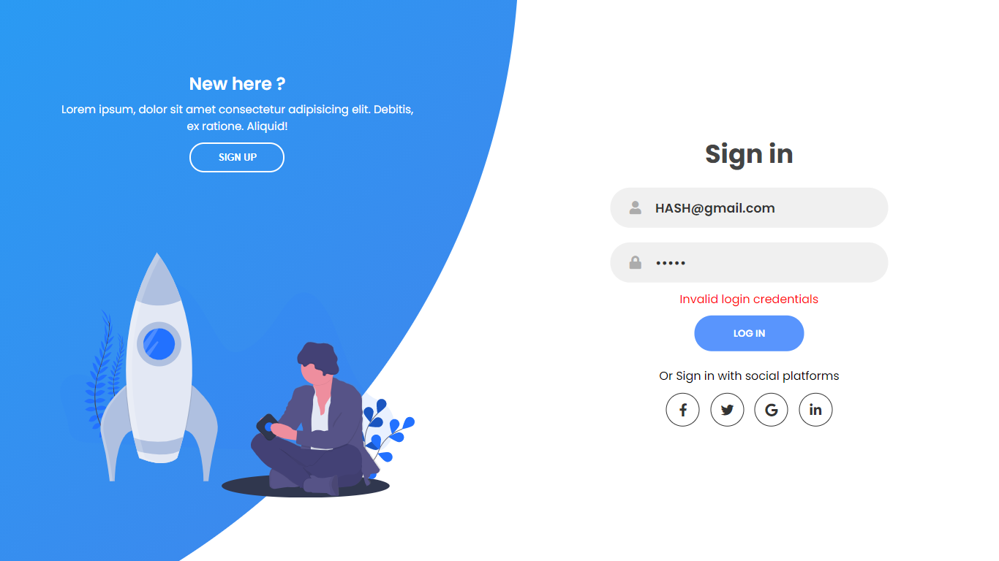
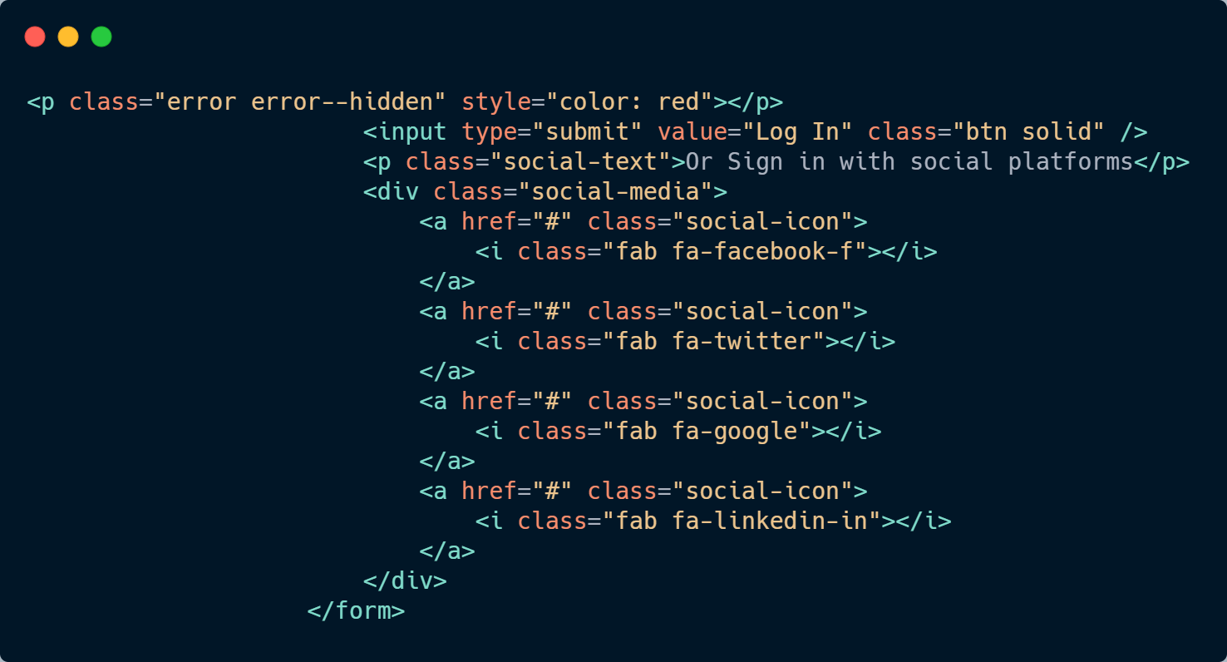

Slide 5
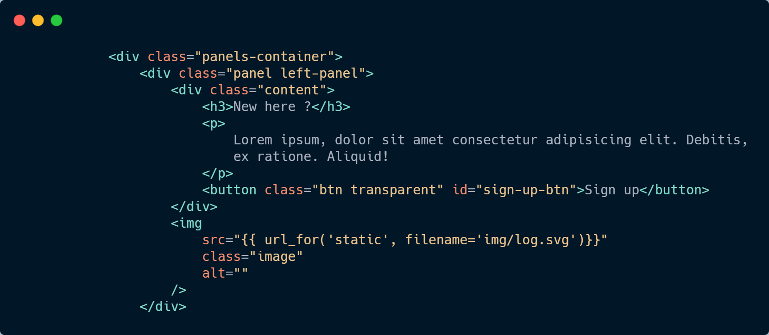

Slide 6
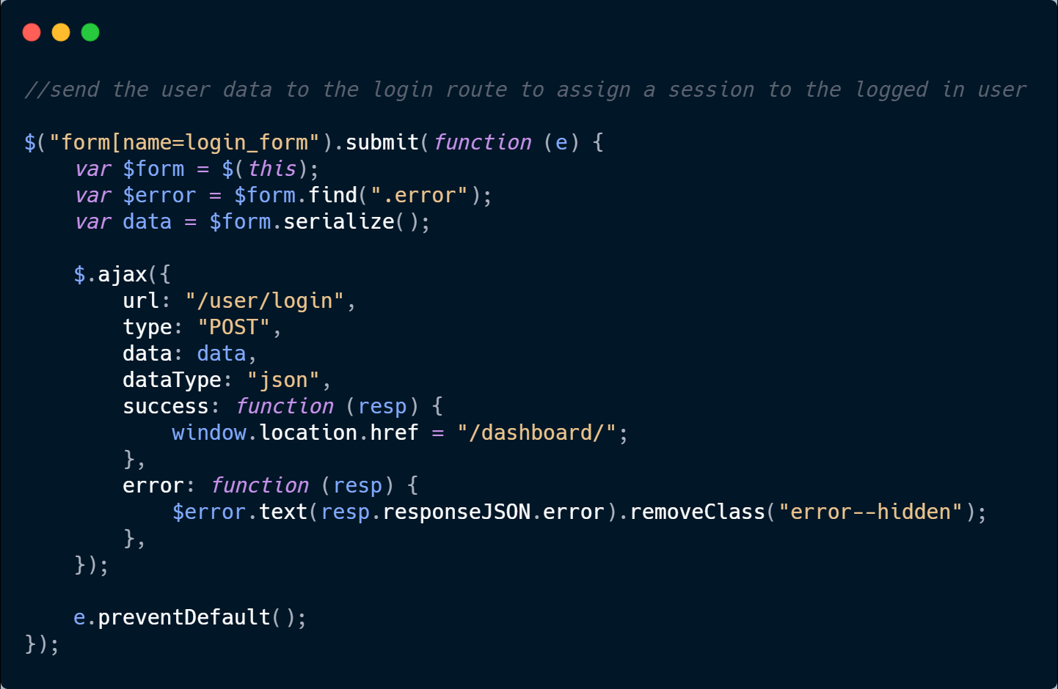

Slide 7

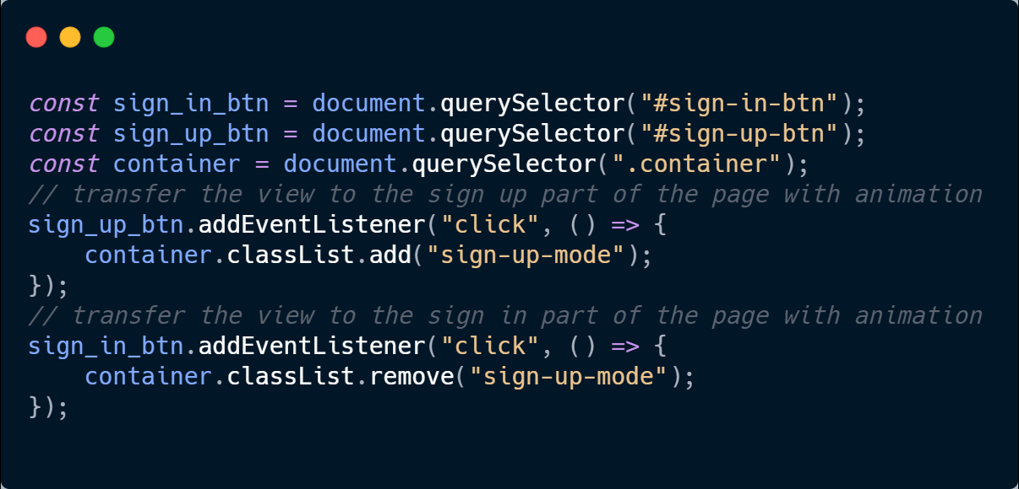

Slide 8
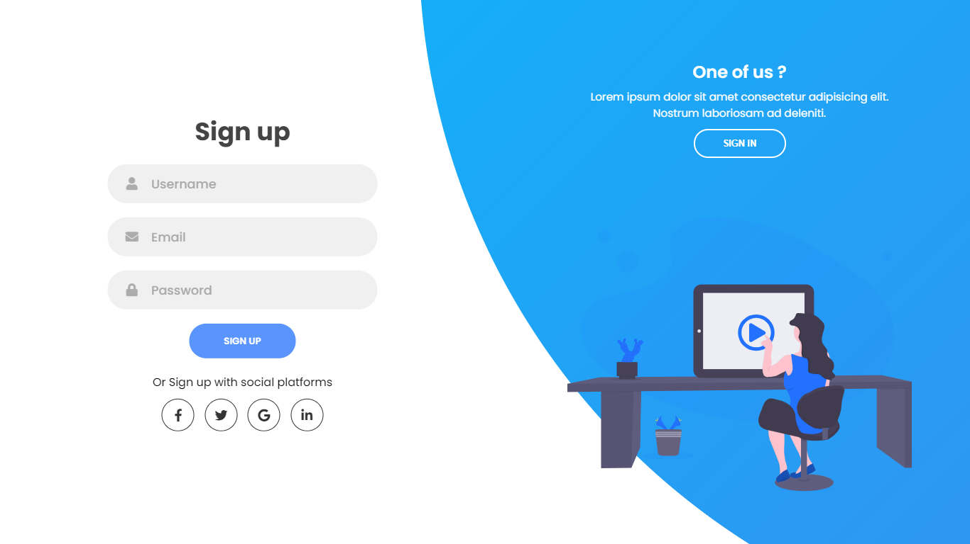

Slide 9
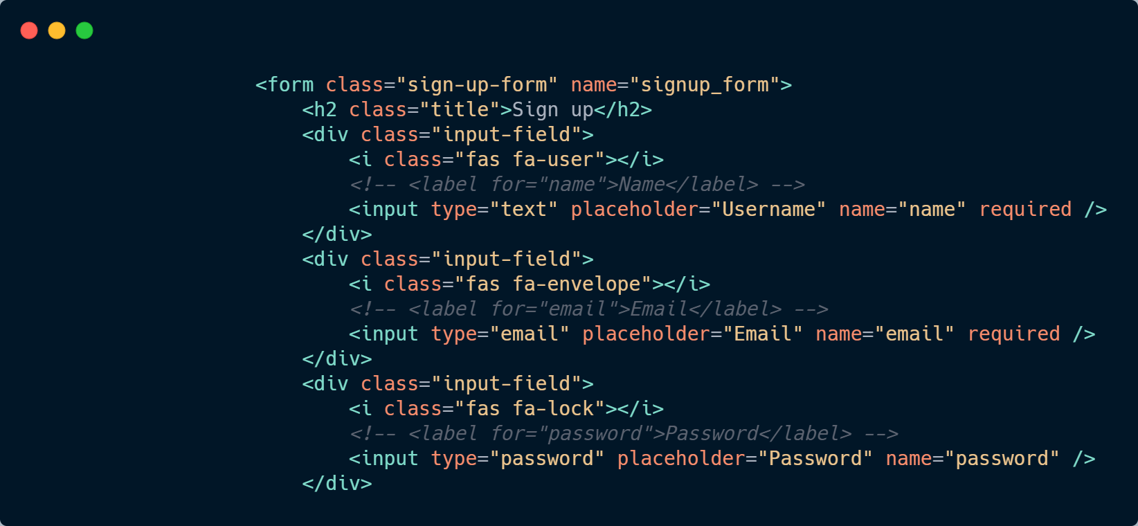

Slide 10
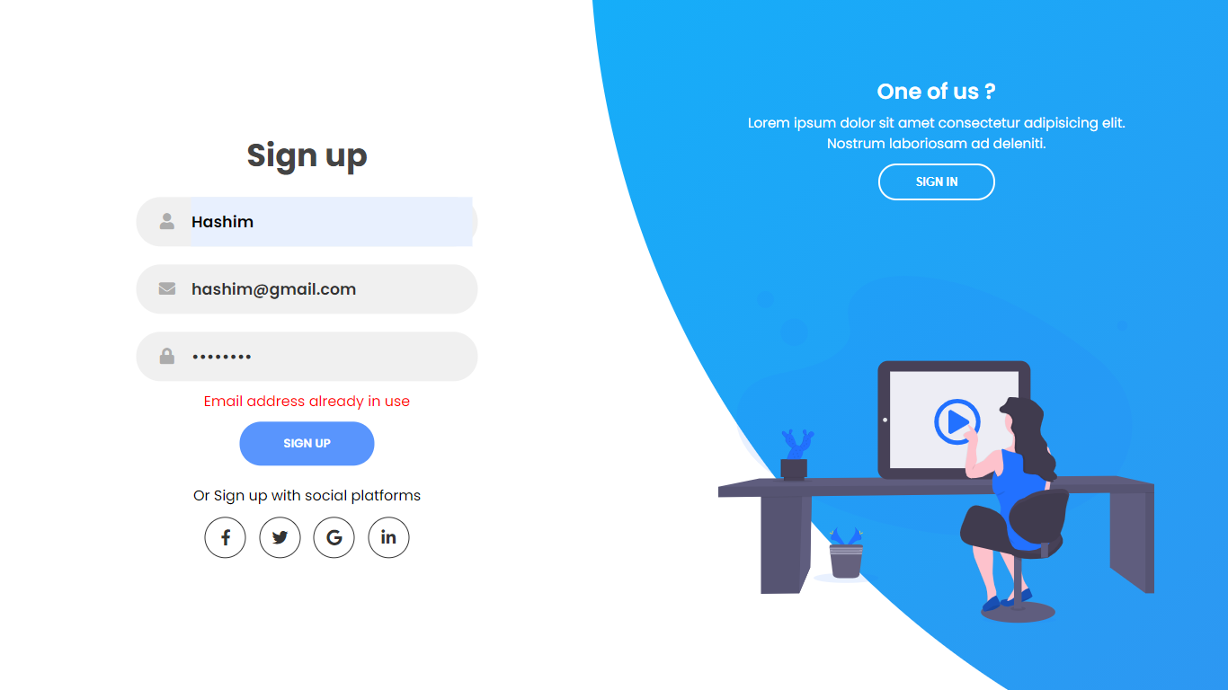
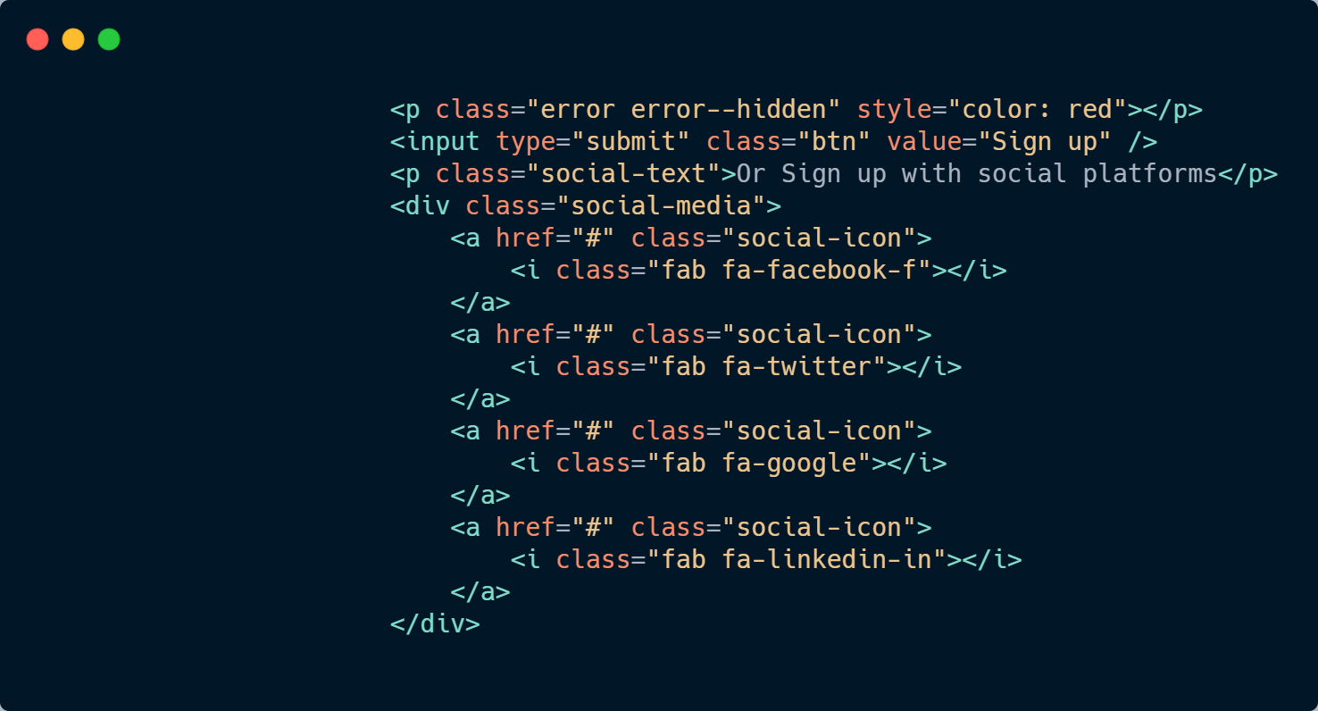

Slide 11
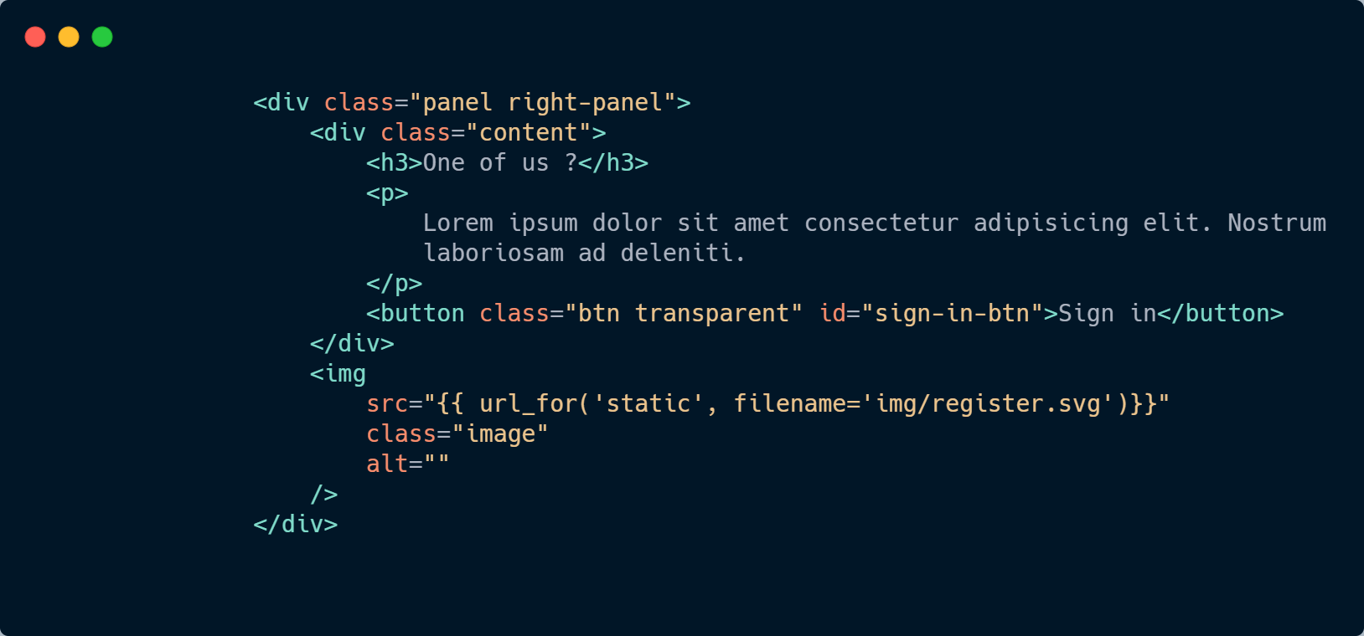

Slide 12
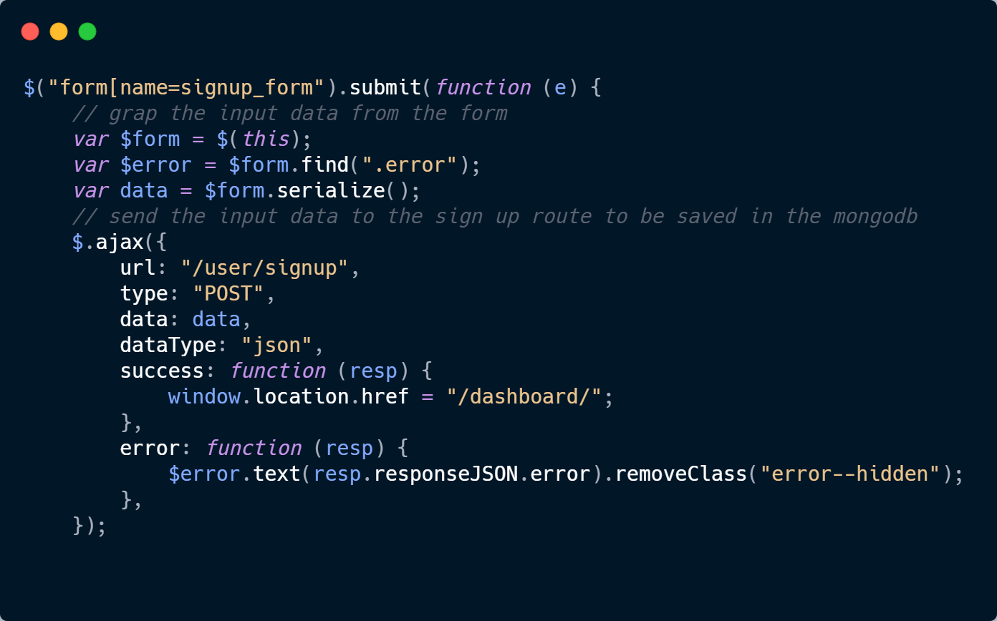

Slide 13
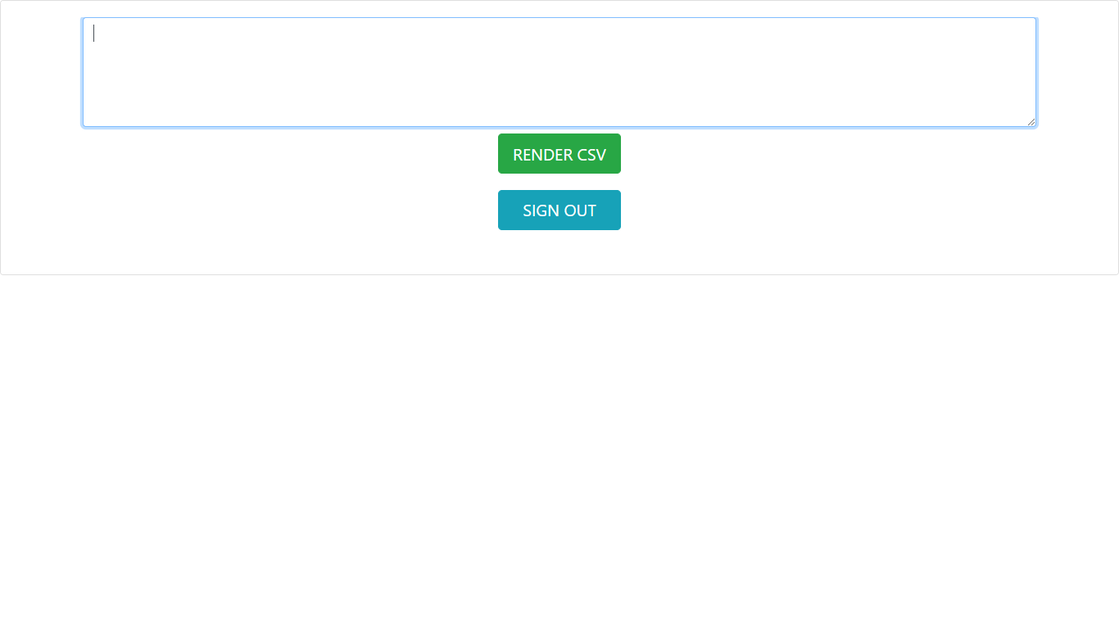
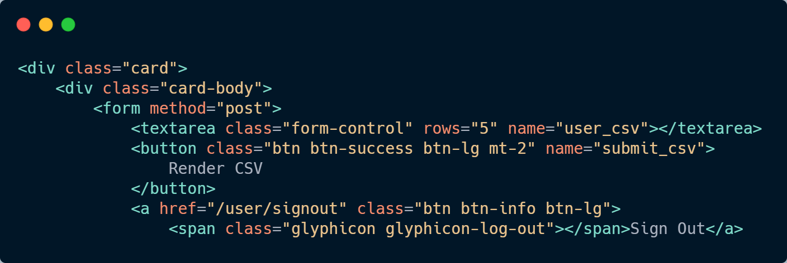

Slide 14
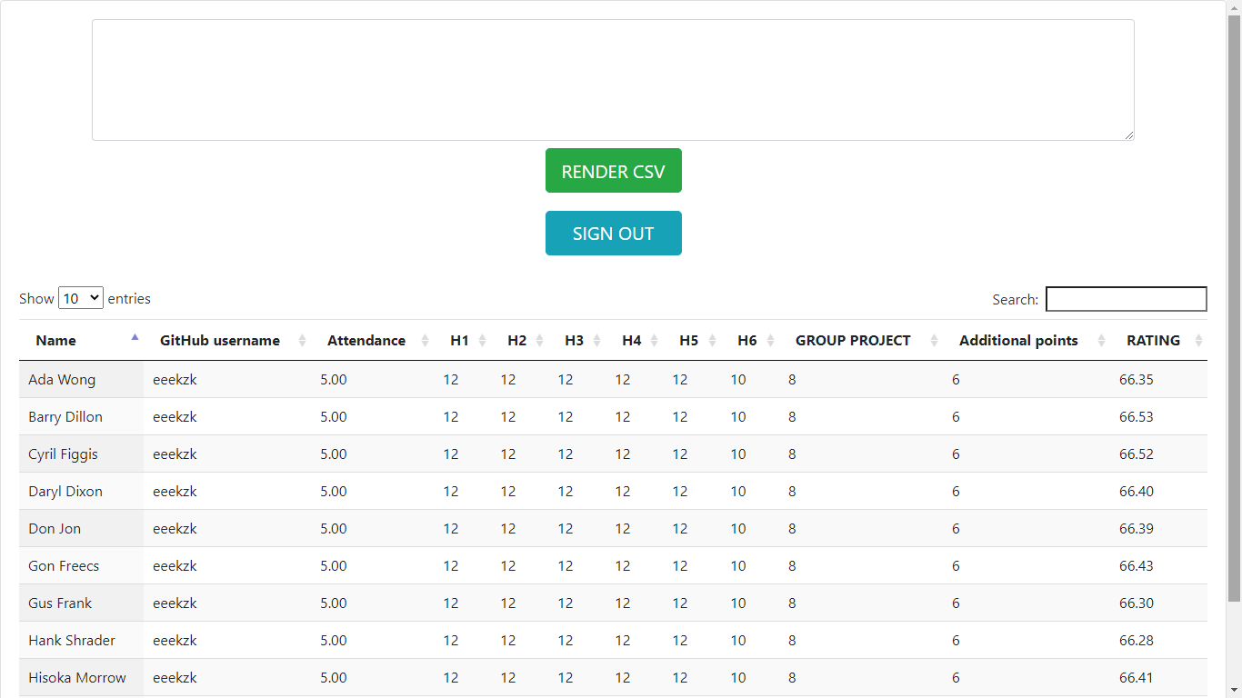
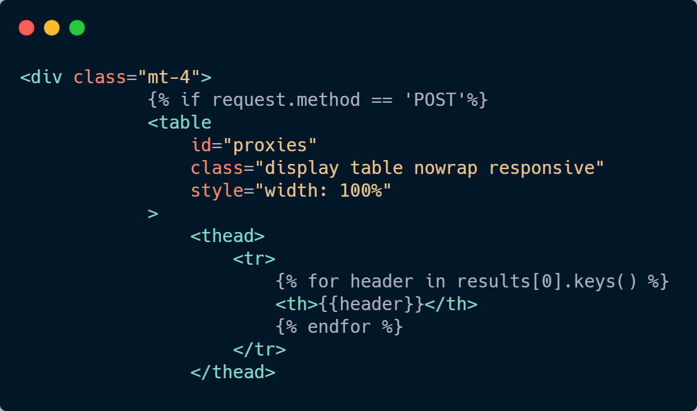

Slide 15
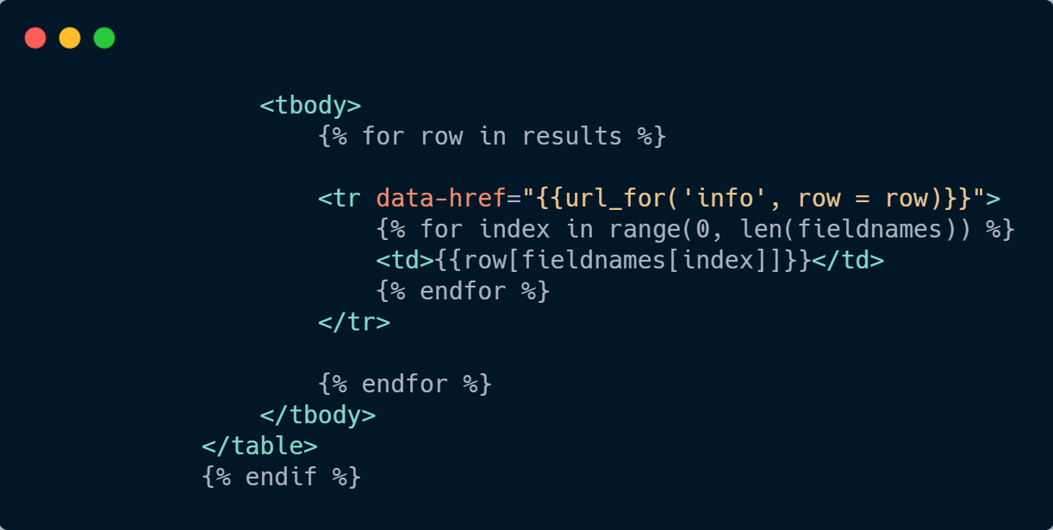

Slide 16
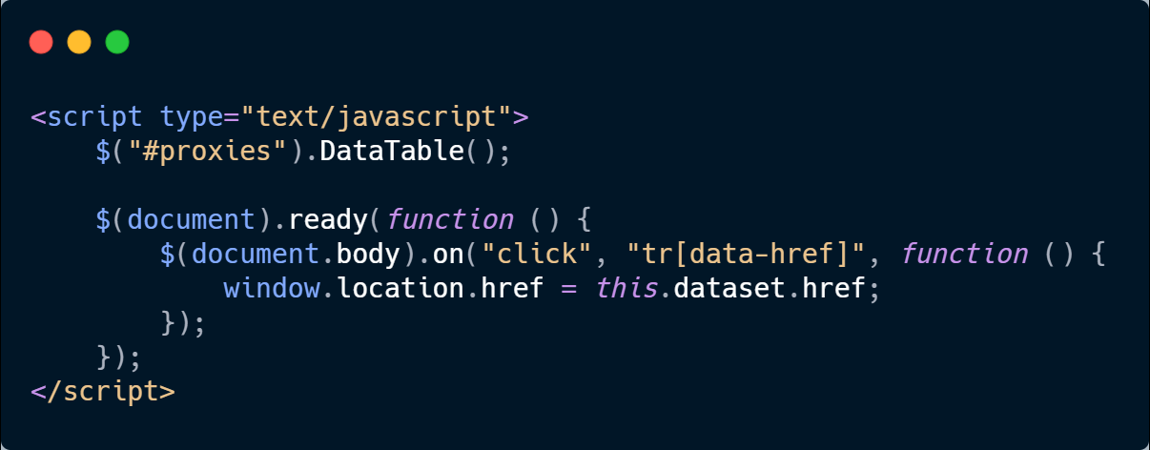

Slide 17
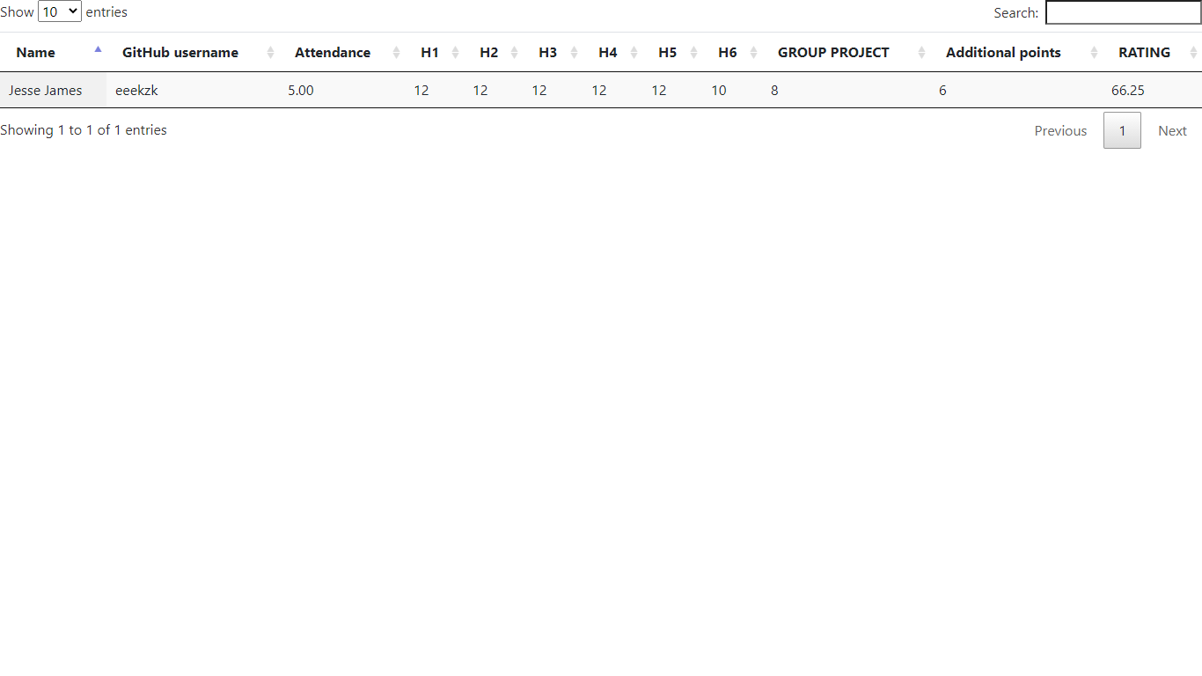
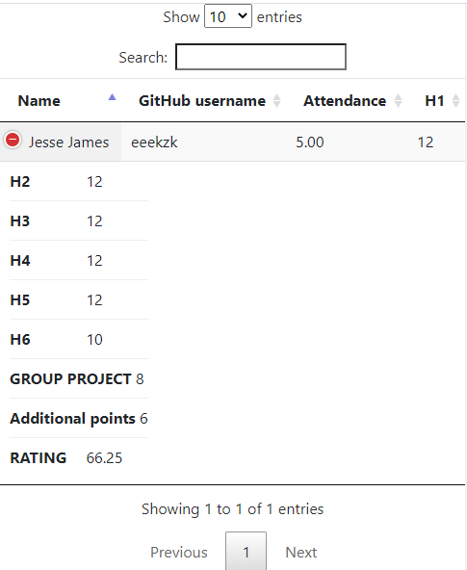
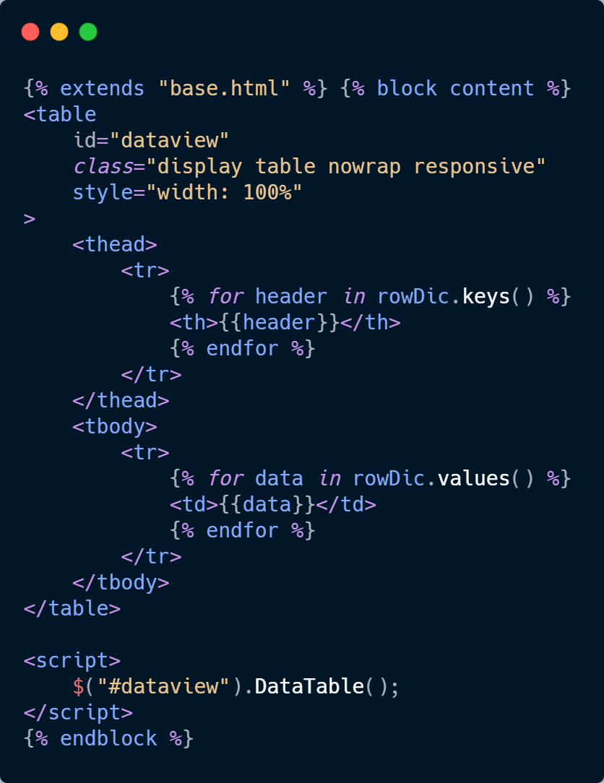

Slide 18

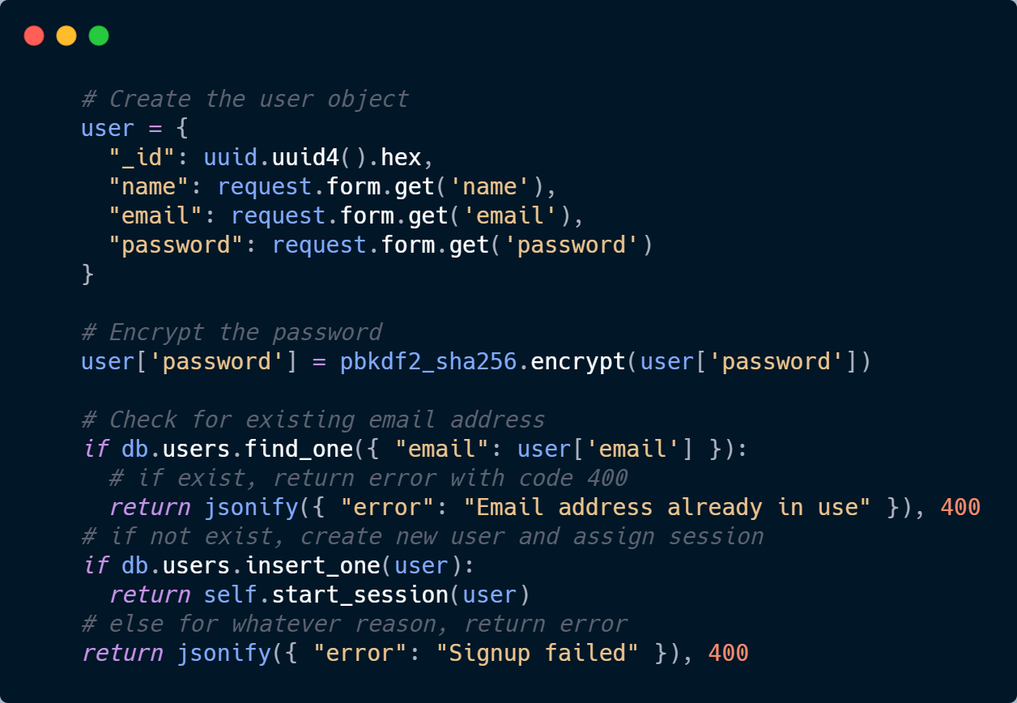
Sign Up
Login
Signup
Exist?
Session
Logged in ?
Sign out
Dashboard

Slide 19
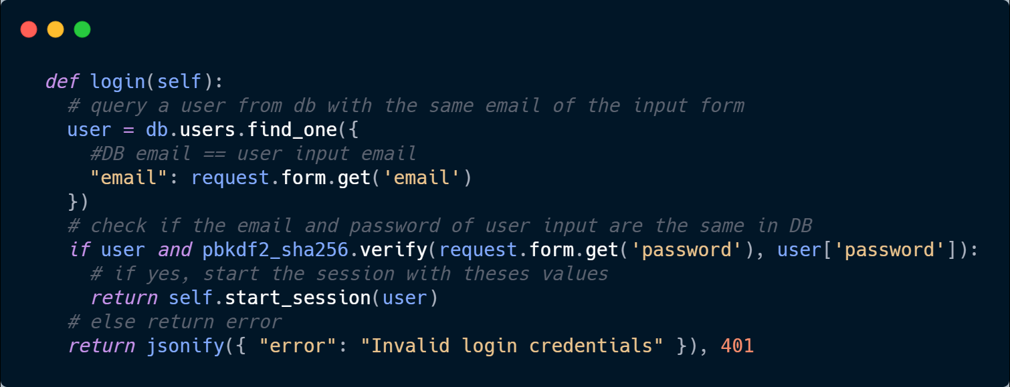
Login
Login
Signup
Exist?
Session
Logged in ?
Sign out
Dashboard

Slide 20
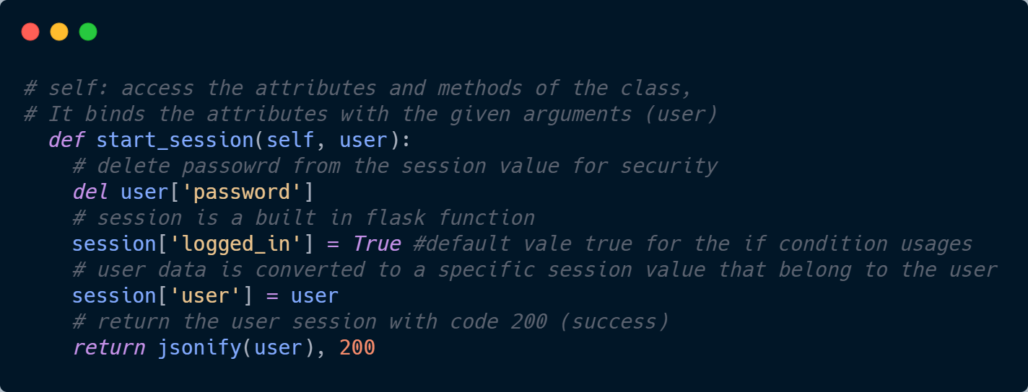
Session
Login
Signup
Exist?
Session
Logged in ?
Sign out
Dashboard

Slide 21
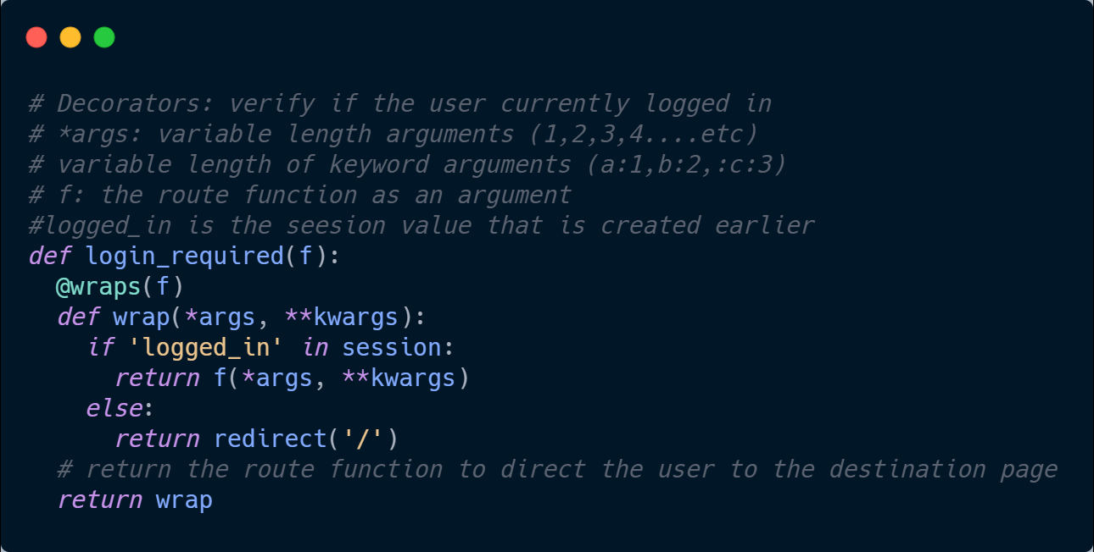
Logged in?
Login
Signup
Exist?
Session
Logged in ?
Sign out
Dashboard

Slide 22
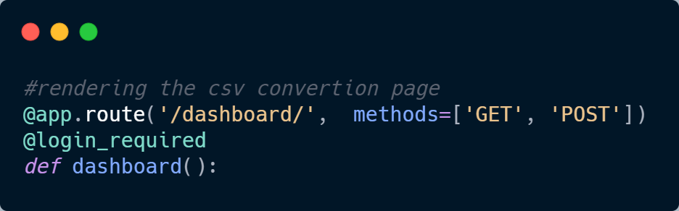
Dashboard
Login
Signup
Exist?
Session
Logged in ?
Sign out
Dashboard

Slide 23
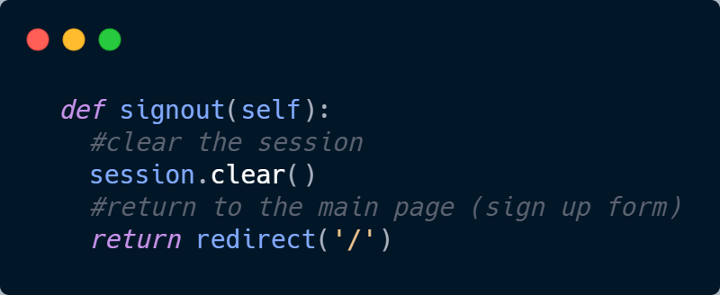
Sign out
Login
Signup
Exist?
Session
Logged in ?
Sign out
Dashboard

Slide 24
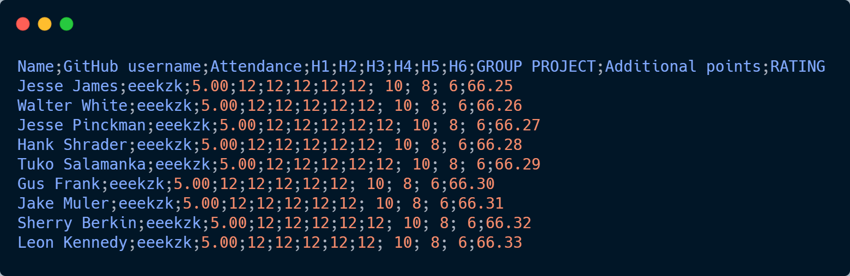
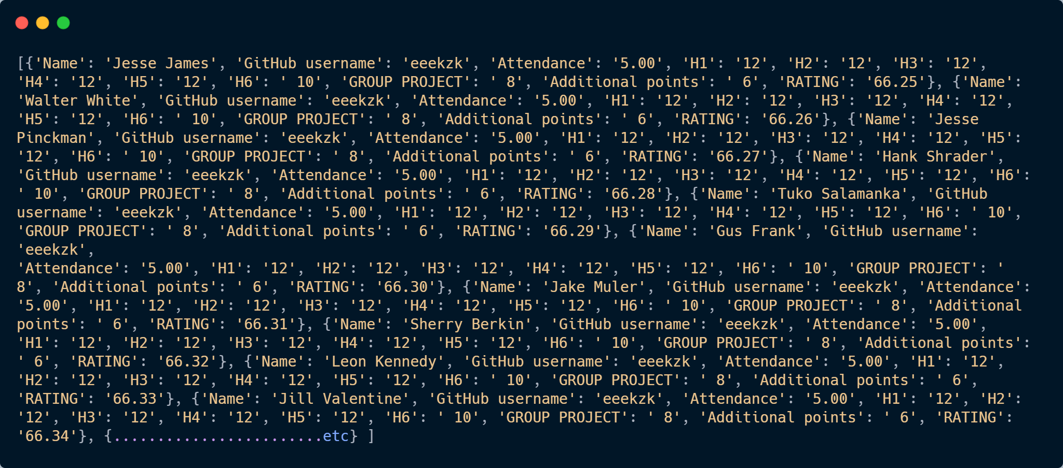

Slide 25

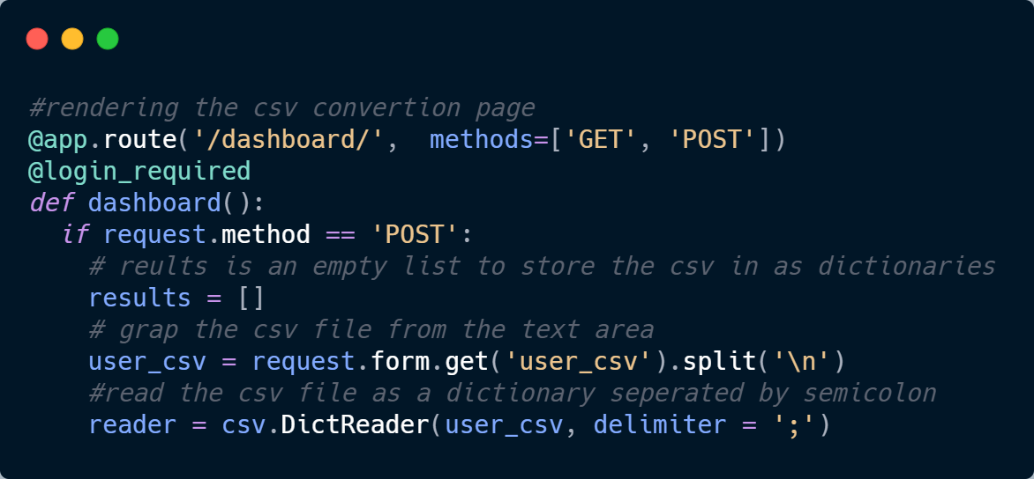
Dashboard: Get ➔ Read
Get
Read

Slide 26
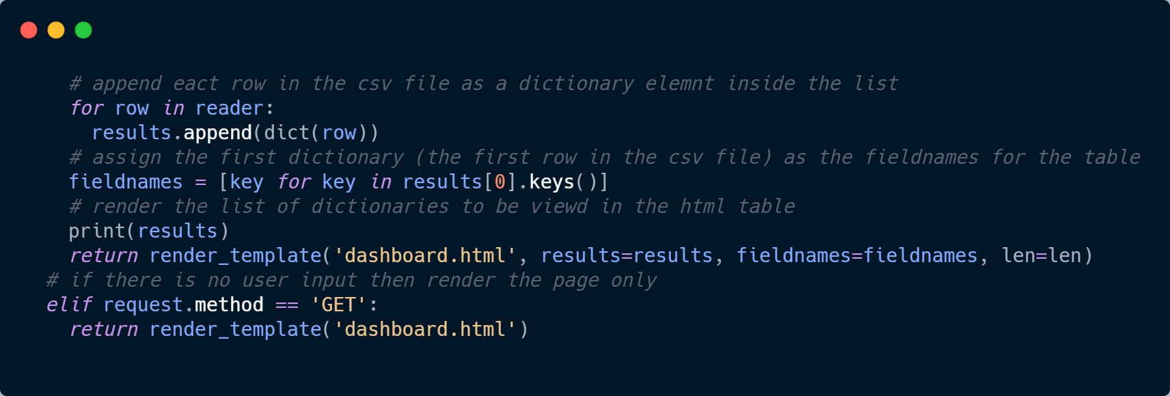
Dashboard: Get ➔ Read ➔Create
Get
Read
Create

Slide 27
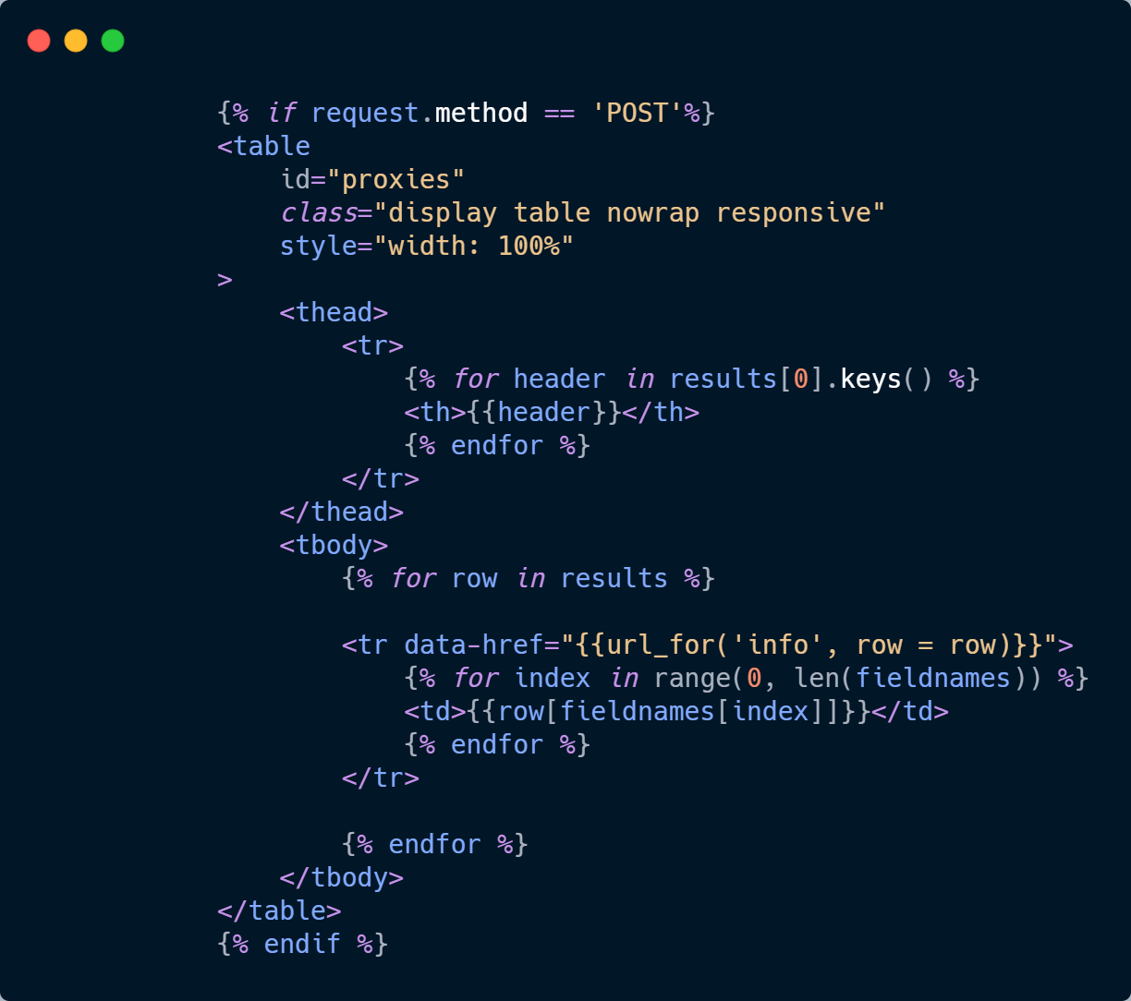
Dashboard: Get ➔ Read ➔Create ➔ Iterate & View
Get
Read
Create
Iterate & View

Slide 28
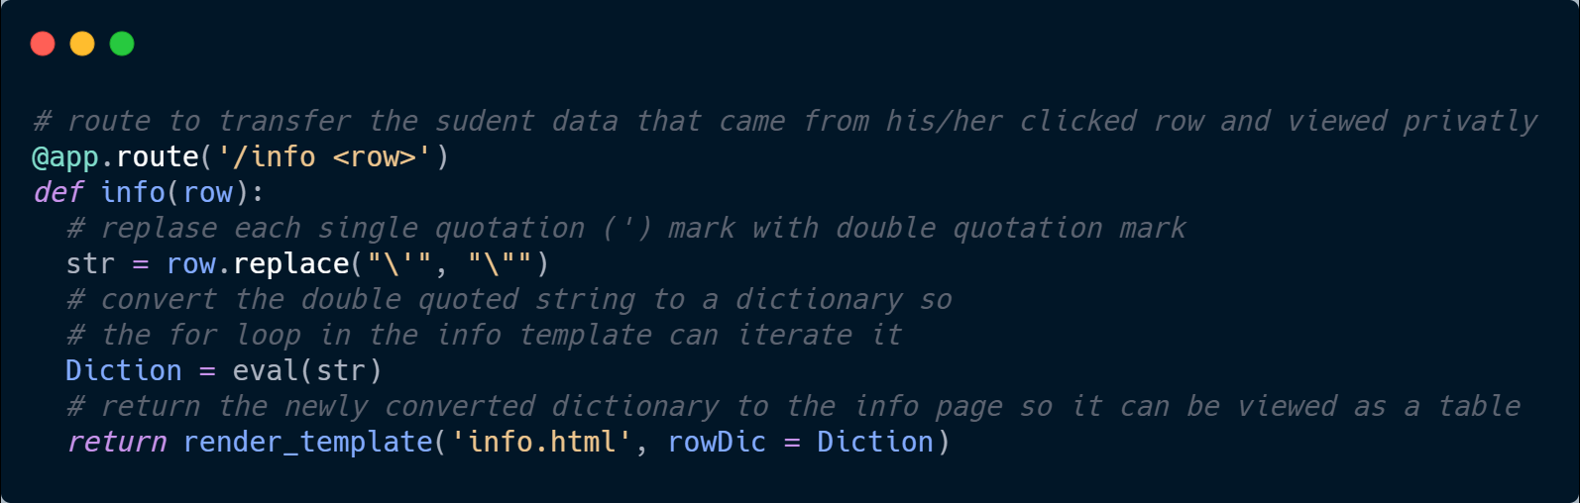
Dashboard: Get ➔ Read ➔Create ➔ iterate & view ➔ Convert
Get
Read
Create
Iterate & View
Convert

Slide 29
Dashboard: Get ➔ Read ➔Create ➔ iterate & view ➔ Convert ➔ Iterate & VIEW
Get
Read
Create
Iterate & View
Convert
Iterate & View

Slide 30

Thank You
Team 7
Supervisor:
A.P. Menshikov Alexander Alekseevich
Students:
Armida Caushaj
Appiah Prince
Hossam Montasser
Hashim Hawwaz

